Slide 1














DATE: 18 JUL, 2026
Sankalp Global School Welcomes You to
PARENT-TEACHER
MEET
CLASS-3
CLASS TEACHER: MANISHA DASH

Slide 2
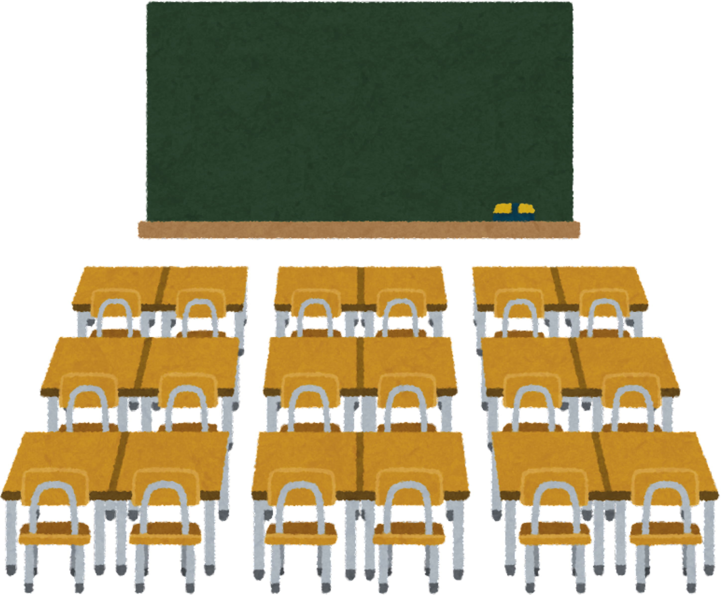

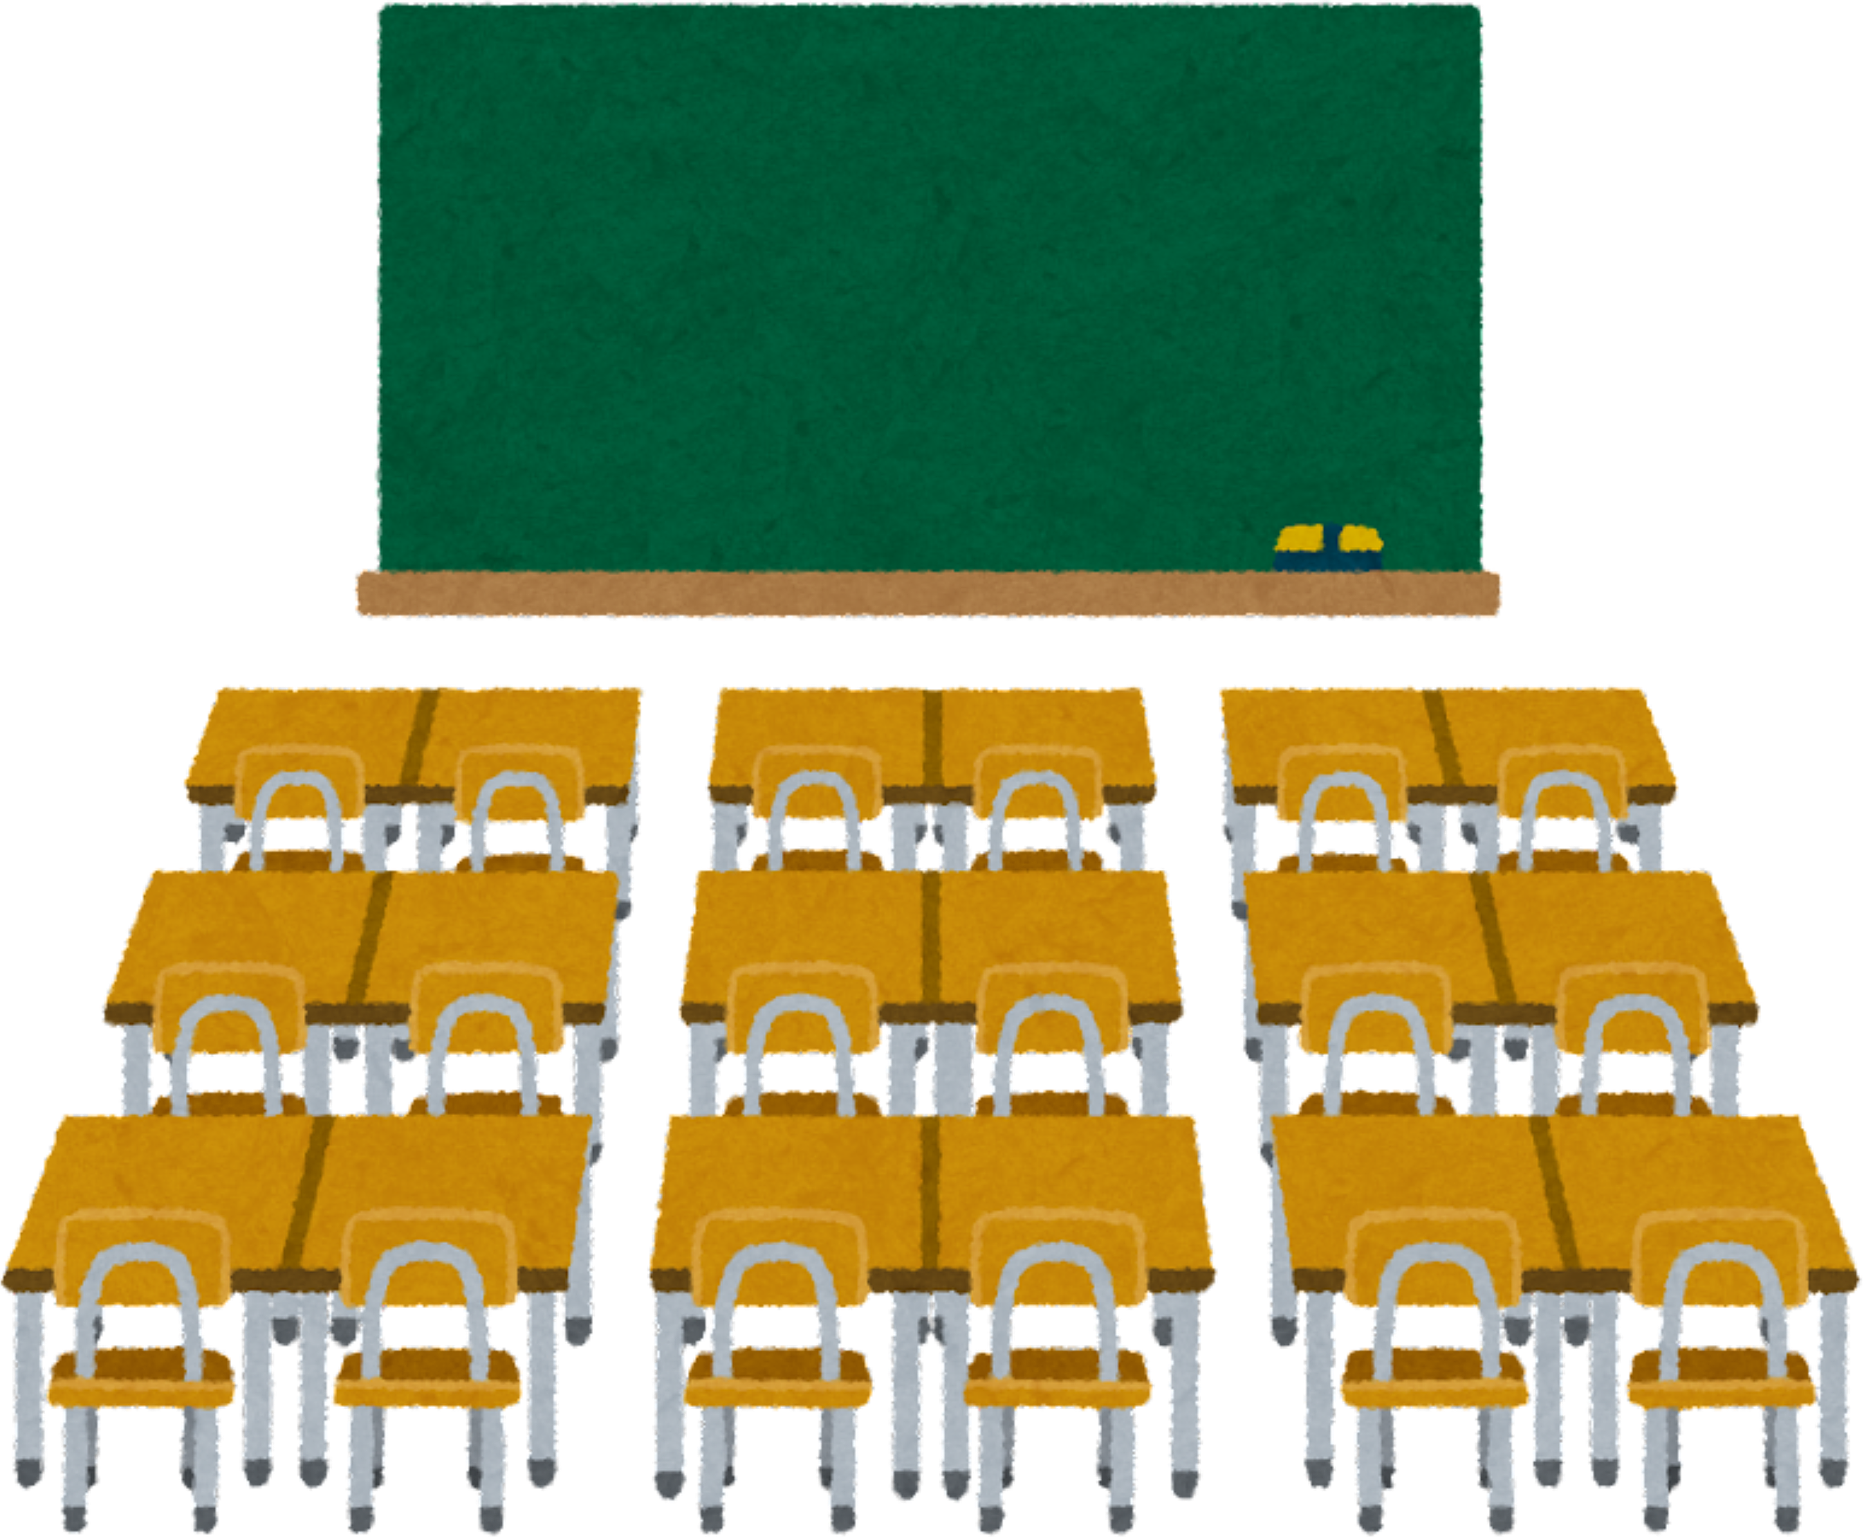
WELCOME
PARENTS!
Thank you for being here today!

Slide 3



ATTENDANCE
CHECKING
The attendance sheet is at the back. Please take your time to sign it.

Slide 4
  DOCUMENTATION & RECORD KEEPING
  School Diary: Please ensure pages 3 and 4 are filled with accurate details.
  Leave Applications: Refer to page 17 for the school-approved format.
  Consent: Kindly sign the consent form on the last page.
  Daily Monitoring: Parents are requested to check the school diary every day for important updates.
  Timetable: Please ensure the student’s timetable is written on page 29.

Slide 5
  SCHOOL DISCIPLINE & PUNCTUALITY
  Arrival Time: The school gate closes at 8:15 AM. Students arriving after this time will not be permitted into class.
  Early Pickup: If a child needs to be picked up early, please provide prior notice at the school office.
  Classroom Distractions: Please ensure your child carries a full stationery kit (sharpened pencil, eraser, sharpener, etc.) daily to avoid disruptions caused by sharing.

Slide 6
  UNIFORM & GROOMING STANDARDS
  Daily Wear: Students must wear clean, ironed uniforms.
  House Uniform (Wed & Sat): House dress with white shoes. Girls must wear white headbands.
  Regular Days: Girls should wear black headbands.
  Personal Grooming: Boys’ hair must be neatly trimmed and combed.
  Book Maintenance: All books and notebooks must be neatly covered and clearly labelled with the student's name.

Slide 7
4. HEALTHY TIFFIN HABITS
  Nutritious Meals: Please provide healthy, homemade, and nutritious food.
  Restricted Items: Strictly avoid junk food (chips, chocolates, soft drinks, noodles, and packaged snacks).
  Dietary Policy: Please note that non-vegetarian food is not allowed.
  Required Accessories: Every student must bring 2 napkins and a spoon/fork daily.
  Encouragement: We encourage including fresh fruits and healthy snacks in the tiffin box.

Slide 8
5. Planning & Communication
  Academic Planning: Please follow the Annual Planner for information on examinations, competitions, observations, and holidays to help your child prepare in advance.
  Monitoring Progress: Kindly review your child’s classwork and homework books regularly.
  Teacher Contact: For any queries, parents may contact the teacher between 5:00 PM and 8:00 PM.

Slide 9

THANK YOU
PARENTS
For your cooperation and for partnering with us in your child's educational journey.

